Slide 1
LANE DEPARTURE WARNING

Slide 2
FEATURES
Lane detection system for use in autonomous / semi-autonomous vehicles as an advanced driver assistance system(ADAS).
Implemented with front facing camera.
Main features include:
Detecting the lane
Measuring the curve radius
Measures offset from centre for ease of driver to centre the vehicle.
This prototype provides visual output display which can be changed to implementation with audio warnings for commercial use of the prototype.

Slide 3
ALGORITHM
Lane detection is carried out by a sliding window approach.
Once the left and right lanes are detected, vehicle's deviation from actual centre of the lane is calculated.
Implemented through a modular approach.
Undistort image
Warp
Isolate lane line pixels
Curve fit
Final image

Slide 4
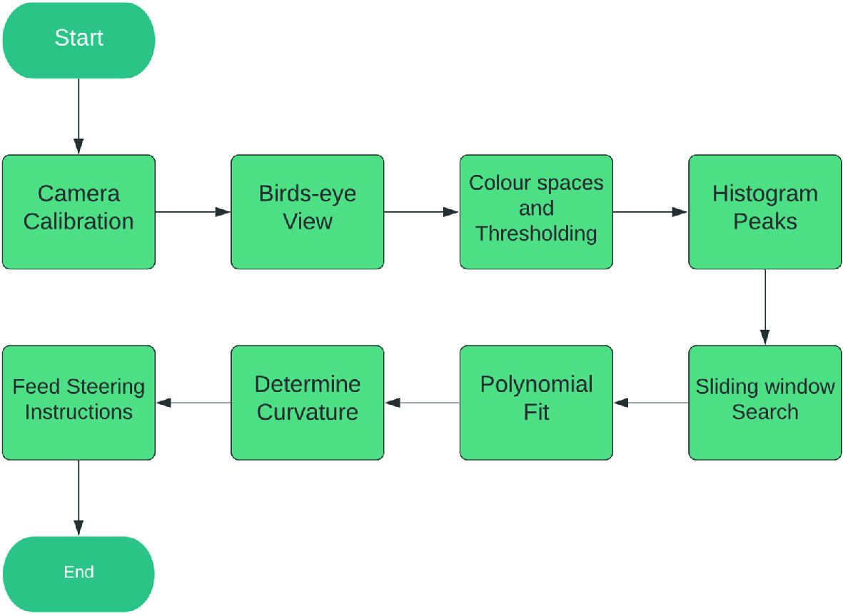

Slide 5
IMAGE PROCESSING
WARP
processimage()
Greyscale the image:
gray = cv2.cvtColor(hls_result, cv2.COLOR_BGR2GRAY)
Gaussian filter: to filter out noise in the image
blur = cv2.GaussianBlur(thresh,(3, 3), 0)
Canny: to detect edges in the image by calculating change in pixel intensity
canny = cv2.Canny(blur, 40, 60)
perspectiveWarp()
Four points plotted on the lane area
Creates birdseye view of lane to get refined image

Slide 6
ISOLATING LANE AND CURVE FIT
plotHistogram()
Calculates white pixels in the image
Indicates left and right lanes
X-coordinates for lanes are identified
slide_window_search():
Sliding window approach is used to detect lanes.
Creates stack with lane at centre.
Based on position of white pixel from histogram, builds up the stack
A second degree polynomial fit is performed to get curve fit
Sliding window approach:
From each peak on the histogram, we initialize windows and then slide them vertically. Each window is horizontally centered in the end of each iteration by its detected pixels inside.
Depending on the number of windows whose number of pixels inside requiring a minimum population, we can predict a confidence level of detected ‘line’ to say if it’s a line or not.

Slide 7
generalsearch()
Finds area around detected lines
Applies second degree polyfit
Draws lines for lane
measure_lane_curvature()
Pixel space converted to meter space
Determines direction
draw_lane_lines()
Takes detected lines and fills the area
Detects and visualize centre of lane:
Takes mean of left_fitx and right_fitx lists
Stores it in pts_mean
Draws the centre line
offCentre()
Calculate the offset value using pts_mean
addText()
Displays the calculates values of curvature and offset
main()
Functions are called and image frames converted to video output

Slide 8
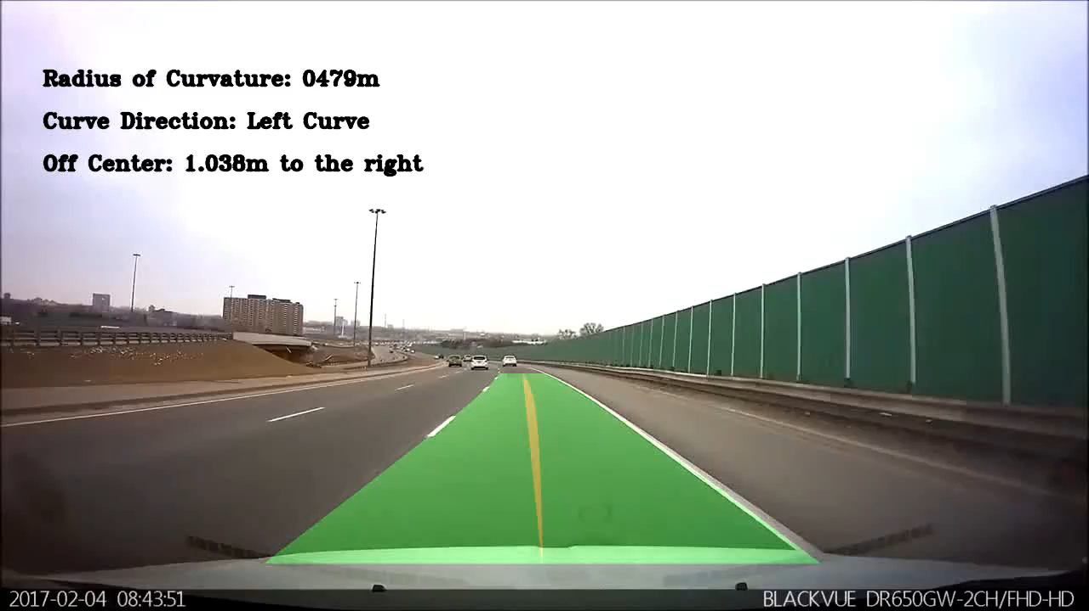
VALIDATION INFORMATION
Output footage

Slide 9
FUTURE WORKS
Further improvements can be made using deep learning techniques.
This project may show slight errors in values depending on:
Unstable light conditions or night-time
Weather conditions.
Certain values are hardcoded which creates a window of error. Dynamic point calculations can solve this.

